Slide 1
Design Patterns
Architectural Patterns

Slide 2
Introduction to Patterns
The recurring aspects of designs are called design patterns.
A pattern is the outline of a reusable solution to a general problem encountered in a particular context
Many of them have been systematically documented for all software developers to use
A good pattern should
Be as general as possible
Contain a solution that has been proven to effectively solve the problem in the indicated context.
Studying patterns is an effective way to learn from the experience of others
Notes:
Introduction to patterns
As you gain experience in object-oriented software development, you will begin
to notice that many parts of your models or designs reappear, with only slight
changes, in many different systems or subsystems. These recurring aspects are
called patterns. Many of them have been systematically documented for all
software developers to use
Definition
Usage of Design Pattern
Design Patterns have two main usages in software development.
Common platform for developers
Design patterns provide a standard terminology and are specific to particular scenario. For example, a singleton design pattern signifies use of single object so all developers familiar with single design pattern will make use of single object and they can tell each other that program is following a singleton pattern.
Best Practices
Design patterns have been evolved over a long period of time and they provide best solutions to certain problems faced during software development. Learning these patterns helps unexperienced developers to learn software design in an easy and faster way.
A design patterns are well-proved solution for solving the specific problem/task.
This concept exists in may domains

Slide 3
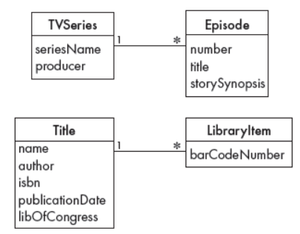
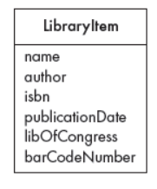
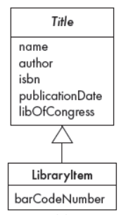

An Example
All the episodes of a television series.
The flights that leave at the same time every day for the same destination.
All the copies of the same book in a library.
Notes:
Often in a domain model you find a set of related objects that we will call
occurrences; the members of such a set share common information but also
differ from each other in important ways.
Examples of sets of occurrences include:
All the episodes of a television series. They have the same producer and the same series title, but different story-lines.
The flights that leave at the same time every day for the same destination. They
have the same flight number, but occur on different dates and carry different
passengers and crew
All the copies of the same book in a library. They have the same title and
author. However, the copies have different barcode identifiers and are
borrowed by different people at different times.

Slide 4
Pattern description
Context:
The general situation in which the pattern applies
Problem:
A short sentence or two raising the main difficulty.
Forces:
The issues or concerns to consider when solving the problem
Solution:
The recommended way to solve the problem in the given context.
‘to balance the forces’
Antipatterns: (Optional)
Solutions that are inferior or do not work in this context.
Related patterns: (Optional)
Patterns that are similar to this pattern.
References:
Who developed or inspired the pattern.
Notes:
Forces: the issues or concerns that you need to consider when solving the
problem. These include criteria for evaluating a good solution

Slide 5
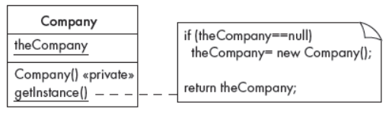
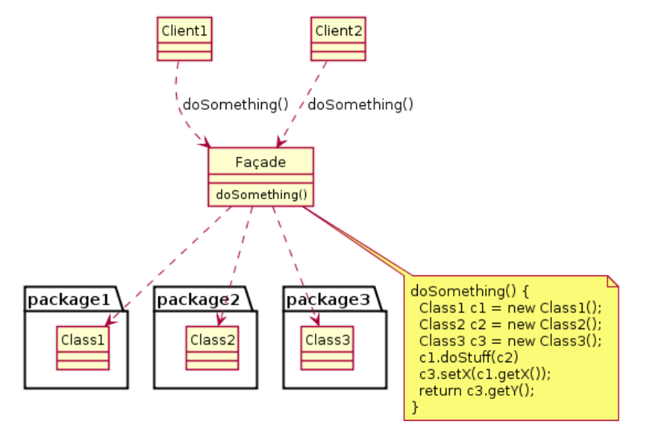
Few Patterns
Creational
- Eg : Singleton
Structural
- Eg : Facade
Behavioral
- Eg : Observer
Notes:
Types of Design Patterns
As per the design pattern reference book Design Patterns - Elements of Reusable Object-Oriented Software , there are 23 design patterns which can be classified in three categories: Creational, Structural and Behavioral patterns. We'll also discuss another category of design pattern: J2EE design patterns.
S.N.Pattern & Description
1Creational Patterns These design patterns provide a way to create objects while hiding the creation logic, rather than instantiating objects directly using new operator. This gives program more flexibility in deciding which objects need to be created for a given use case
.2Structural Patterns These design patterns concern class and object composition. Concept of inheritance is used to compose interfaces and define ways to compose objects to obtain new functionalities.
3Behavioral Patterns These design patterns are specifically concerned with communication between objects.
The Singleton pattern
Context In software systems, it is very common to find classes for which you want only
one instance to exist. Such a class is called a singleton.
For example, the Company or University classes in systems that run the business
of that company or university might be singletons. Another example is the
MainWindow class in a graphical user interface for systems that can only have one
main window open.
Context Often, an application contains several complex packages. A programmer
working with such packages has to manipulate many different classes.
Problem How do you simplify the view that programmers have of a complex package?
Forces It is hard for a programmer to understand and use an entire subsystem – in
particular, to determine which methods are public. If several different
application classes call methods of the complex package, then any modifications
made to the package will necessitate a complete review of all these classes.
Solution Create a special class, called a ≪Facade≫, which will simplify the use of the
package. The ≪Facade≫ will contain a simplified set of public methods such that
most other subsystems do not need to access the other classes in the package.
The net result is that the package as a whole is easier to use and has a reduced
number of dependencies with other packages. Any change made to the package
should only necessitate a redesign of the ≪Façade≫ class, not classes in other
packages.

Slide 6
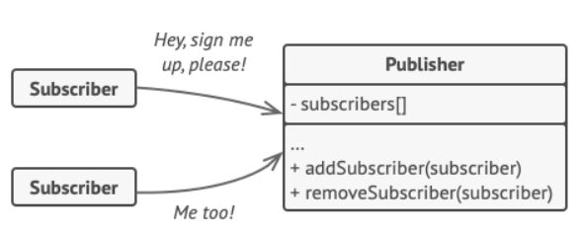
The Observer Pattern
Notes:
This pattern is a one-to-many dependency between objects so that when one object changes state, all its dependents are notified. This is typically done by calling one of their methods.
For the sake of simplicity, think about what happens when you follow someone on Twitter. You are essentially asking Twitter to send you (the observer) tweet updates of the person (the subject) you followed.

Slide 7
The Observer Pattern
Context:
When an association is created between two classes, the code for the classes becomes inseparable.
If you want to reuse one class, then you also have to reuse the other.
Problem:
How do you reduce the interconnection between classes, especially between classes that belong to different modules or subsystems?
Forces:
You want to maximize the flexibility of the system to the greatest extent possible

Slide 8
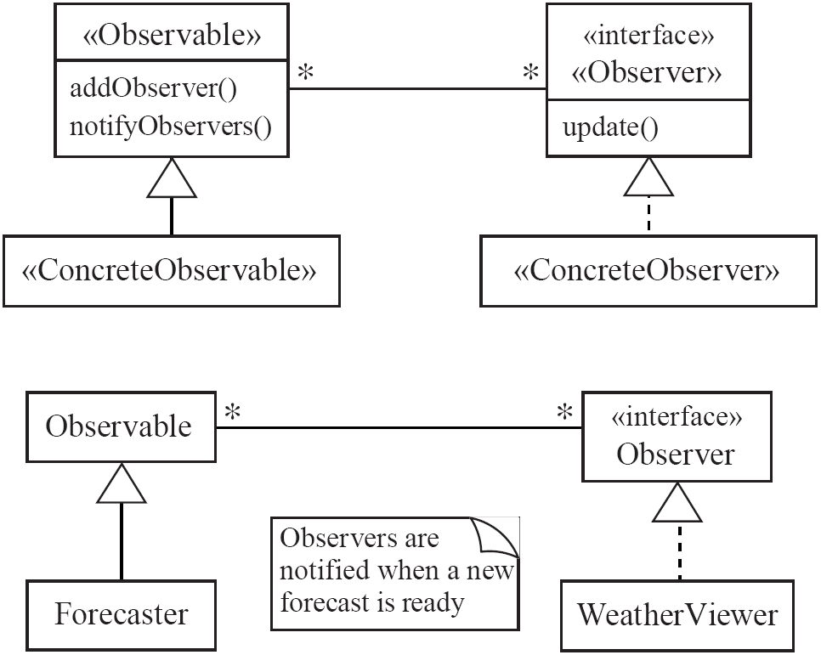
Observer
Solution:

Slide 9
Observer
Antipatterns:
Connect an observer directly to an observable so that they both have references to each other.
Make the observers subclasses of the observable.
References
The Observer pattern is one of the ‘Gang of Four’ patterns. It is also widely known as Publish-and-Subscribe (the observers are Subscribers and the
observable is a Publisher).

Slide 10
Software Architecture
Software architecture is process of designing the global organization of a software system, including:
Dividing software into subsystems.
Deciding how these will interact.
Determining their interfaces.
The architecture is the core of the design, so all software engineers need to understand it.
The architecture will often constrain the overall efficiency, reusability and maintainability of the system.
Notes:
Software architecture is similar. It plays a central role in software engineering,
and involves the development of a variety of high-level views of the system
architectural model will often constrain the overall efficiency, reusability
and maintainability of the system. Poor decisions made while creating this
model will constrain subsequent design.
When developing custom software, the architecture should be expressed
clearly enough that it can be used to communicate effectively with clients. The
clients may not need to know other details of the design. However, they often
want to understand the architecture so that they can be confident the software
is being designed well, and can monitor development progress. The
architectural diagrams used for the construction of buildings are also used to
communicate with clients.

Slide 11
The importance of software architecture
Why you need to develop an architectural model:
To enable everyone to better understand the system
To allow people to work on individual pieces of the system in isolation
To prepare for extension of the system
To facilitate reuse and reusability
Notes:
A good architectural model allows people to understand how the
system as a whole works; it also defines the terms that people use when they
communicate with each other about lower-level details
The
work of developing a complex software system must be distributed among a
large number of people. The architecture allows the planning and coordination
of this distributed work. The architecture should provide sufficient
information so that the work of the individual people or teams can later on be
integrated to form the final system. It is for that reason that the interfaces and
dynamic interactions among the subsystems are an important part of the
architecture.
system. With a complete architectural model,
it becomes easier to plan the evolution of the system It is then possible to see
how the new elements will be integrated, and where they will be connected to
the system. Architects designing buildings often use this technique – their
drawings show not only the proposed building but also its future extensions
(Phase I, Phase II, etc.). Specialists like electrical engineers can then plan the
cabling to take into account the future needs of the foreseen extension
The architectural model makes each system
component visible. This is an important benefit since it encourages reuse. By
analyzing the architecture, you can discover those components that can be
obtained from past projects or from third parties. You can also identify
components that have high potential reusability. Making the architecture as
generic as possible is a key to ensuring reusability

Slide 12
Contents of a good architectural model
A system’s architecture will often be expressed in terms of several different views
The logical breakdown into subsystems
The interfaces among the subsystems
The dynamics of the interaction among components at run time
The data that will be shared among the subsystems
The components that will exist at run time, and the machines or devices on which they will be located
Notes:
The logical breakdown into subsystems. This is often shown using package
diagrams, which we will describe later. The interfaces among the subsystems
must also be carefully described.
The dynamics of the interaction among components at run time, perhaps
expressed using interaction or activity diagrams.
The data that will be shared among the subsystems, typically expressed using
class diagrams.
The components that will exist at run time, and the machines or devices on
which they will be located. This information can be expressed using
component and deployment diagrams,

Slide 13
Design stable architecture
To ensure the maintainability and reliability of a system, an architectural model must be designed to be stable.
Being stable means that the new features can be easily added with only small changes to the architecture

Slide 14
Developing an architectural model
Start by sketching an outline of the architecture
Based on the principal requirements and use cases
Determine the main components that will be needed
Choose among the various architectural patterns
Discussed next
Suggestion: have several different teams independently develop a first draft of the architecture and merge together the best ideas
Notes:
The following are some steps that you can use iteratively as you refine the
Architecture
based on the principal
requirements, including the domain model and use cases. At this stage, you can
determine the main components that will be needed, such as databases,
particular hardware devices and the main software subsystems. You can also
choose among the various architectural patterns we will discuss later, such as
using a client–server architecture or a pipe-and-filter architecture. It can be
worthwhile having several different teams independently develop a first draft
of the architecture; the teams can then meet to pick the best architecture, or to
merge together the best ideas.

Slide 15
Developing an architectural model
Refine the architecture
Identify the main ways in which the components will interact and the interfaces between them
Decide how each piece of data and functionality will be distributed among the various components
Determine if you can re-use an existing framework, if you can build a framework
Consider each use case and adjust the architecture to make it realizable
Mature the architecture
Notes:
Refine based on

Slide 16
Describing an architecture using UML
All UML diagrams can be useful to describe aspects of the architectural model
UML diagrams are particularly suitable for architecture modelling:
Package diagrams
Component diagrams
Deployment diagrams
Notes:
All UML diagrams can be useful to describe aspects of the architectural model.
Remember that the goal of architecture is to describe the system at a very high
level, with emphasis on software components and their interfaces. Use case
diagrams can provide a good summary of the system from the user’s
perspective. Class diagrams can be used to indicate the services offered by
components and the main data to be stored. Interaction diagrams can be used
to define the protocol used when two components communicate with each
other.
In addition to the UML diagrams we have already studied in this book, three
other types of UML diagram are particularly important for architecture
modeling: package diagrams, component diagrams and deployment diagrams.
These are used to describe different aspects of the organization of the system. In
the next three subsections we will survey the essentials of these types of
diagram.

Slide 17
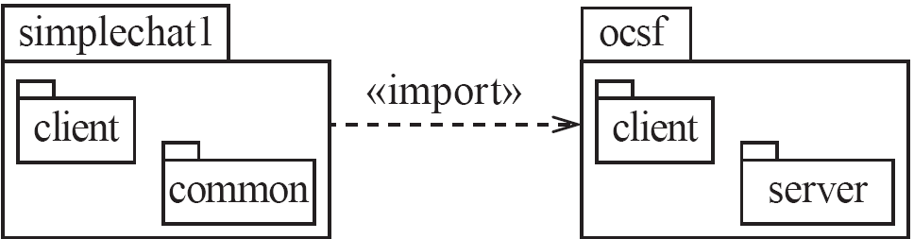
Package diagrams
Notes:
In UML, a package is a collection of modeling elements that are grouped
together because they are logically related.
Inside the box you can put practically anything, including classes, instances, text
or other packages.
When you define a package, you should apply the principles of cohesion and
coupling discussed earlier. Increasing cohesion means ensuring that a package
only has related classes; decreasing coupling means decreasing the number of
dependencies as much as possible

Slide 18

Component diagrams
Notes:
A component diagram shows how a system’s components – that is, the physical
elements such as files, executables, etc. – relate to each other. The UML symbol
for a component is a box with a little ‘plug’ symbol in the top-right corner. An
example is shown in Figure 9.7; many more examples can be found in the next
section.
A component provides one or more interfaces for other components to use.
The same ‘lollipop’ symbol is used for an interface as was introduced in
Chapter 5. To show a component using an interface provided by another, you
use a semi-circle at the end of a line
together.
Various relationships can exist among components, for example:
■ A component may execute another component, or a method in the other
component.
■ A component may generate another component.
■ Two components may communicate with each other using a network

Slide 19
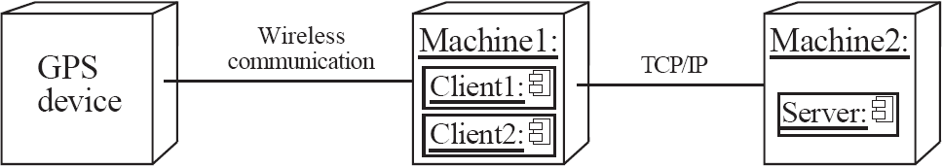
Deployment diagrams
Notes:
A deployment diagram describes the hardware where various instances of
components reside at run time. An example is shown in Figure 9.8. A node in a
deployment diagram represents a computational unit such as a computer, a
processing card, a sensor or a device. It appears as a three-dimensional box.
The links between nodes show how communication takes place. Each node of
a deployment diagram can include one or several run-time software
components. Various artifacts such as files can also be shown inside nodes

Slide 20
Architectural Patterns
The notion of patterns can be applied to software architecture.
These are called architectural patterns or architectural styles.
Each allows you to design flexible systems using components
The components are as independent of each other as possible.

Slide 21
The Multi-Layer architectural pattern
In a layered system, each layer communicates only with the layer immediately below it.
Each layer has a well-defined interface used by the layer immediately above.
The higher layer sees the lower layer as a set of services.
A complex system can be built by superposing layers at increasing levels of abstraction.
Layers immediately below the UI layer provide the application functions determined by the use-cases.
Bottom layers provide general services.
e.g. network communication, database access

Slide 22
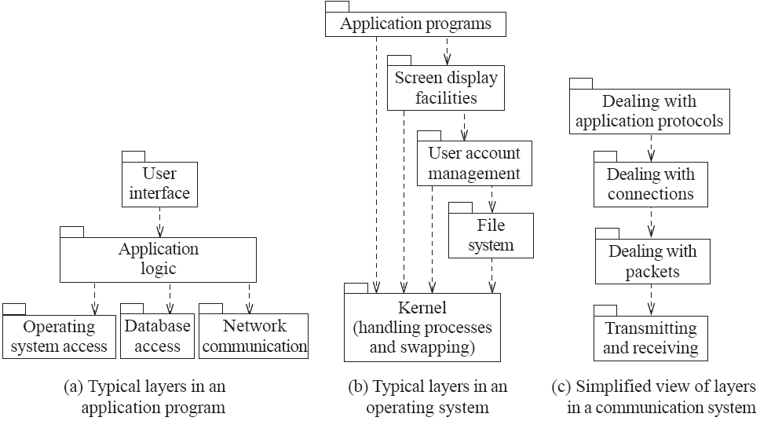
Example of multi-layer systems
Notes:
each layer communicates only with the
layers below it – in many cases, only the layer immediately below it. Each layer
has a well-defined API, defining the services it provides.
A complex system can be built by superimposing layers at increasing levels of
abstraction. The Multi-Layer architectural pattern makes it possible to replace a
layer by an improved version, or one with a different set of capabilities

Slide 23
The multi-layer architecture and design principles
1. Divide and conquer: The layers can be independently designed.
2. Increase cohesion: Well-designed layers have layer cohesion.
3. Reduce coupling: Well-designed lower layers do not know about the higher layers and the only connection between layers is through the API.
4. Increase abstraction: you do not need to know the details of how the lower layers are implemented.
5. Increase reusability: The lower layers can often be designed generically.

Slide 24
The multi-layer architecture and design principles
6. Increase reuse: You can often reuse layers built by others that provide the services you need.
7. Increase flexibility: you can add new facilities built on lower-level services, or replace higher-level layers.
8. Anticipate obsolescence: By isolating components in separate layers, the system becomes more resistant to obsolescence.
9. Design for portability: All the dependent facilities can be isolated in one of the lower layers.
10. Design for testability: Layers can be tested independently.
11. Design defensively: The APIs of layers are natural places to build in rigorous assertion-checking.

Slide 25
The Client-Server and other distributed architectural patterns
There is at least one component that has the role of server, waiting for and then handling connections.
There is at least one component that has the role of client, initiating connections in order to obtain some service.
A further extension is the Peer-to-Peer pattern.
A system composed of various software components that are distributed over several hosts.

Slide 26
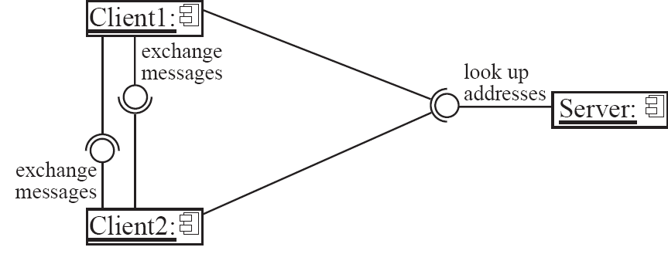
An example of a distributed system

Slide 27
The distributed architecture and design principles
1. Divide and conquer: Dividing the system into client and server processes is a strong way to divide the system.
Each can be separately developed.
2. Increase cohesion: The server can provide a cohesive service to clients.
3. Reduce coupling: There is usually only one communication channel exchanging simple messages.
4. Increase abstraction: Separate distributed components are often good abstractions.
6. Increase reuse: It is often possible to find suitable frameworks on which to build good distributed systems
However, client-server systems are often very application specific.

Slide 28
The distributed architecture and design principles
7. Design for flexibility: Distributed systems can often be easily reconfigured by adding extra servers or clients.
9. Design for portability: You can write clients for new platforms without having to port the server.
10 Design for testability: You can test clients and servers independently.
11. Design defensively: You can put rigorous checks in the message handling code.

Slide 29
The Broker architectural pattern
Transparently distribute aspects of the software system to different nodes
An object can call methods of another object without knowing that this object is remotely located.
CORBA is a well-known open standard that allows you to build this kind of architecture.

Slide 30
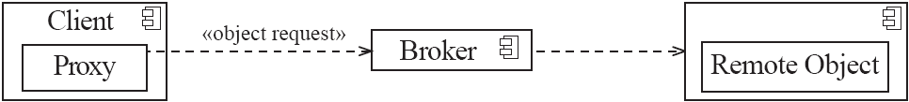
Example of a Broker system

Slide 31
The broker architecture and design principles
1. Divide and conquer: The remote objects can be independently designed.
5. Increase reusability: It is often possible to design the remote objects so that other systems can use them too.
6. Increase reuse: You may be able to reuse remote objects that others have created.
7. Design for flexibility: The brokers can be updated as required, or the proxy can communicate with a different remote object.
9. Design for portability: You can write clients for new platforms while still accessing brokers and remote objects on other platforms.
11. Design defensively: You can provide careful assertion checking in the remote objects.

Slide 32
The Transaction-Processing architectural pattern
A process reads a series of inputs one by one.
Each input describes a transaction – a command that typically some change to the data stored by the system
There is a transaction dispatcher component that decides what to do with each transaction
This dispatches a procedure call or message to one of a series of component that will handle the transaction

Slide 33
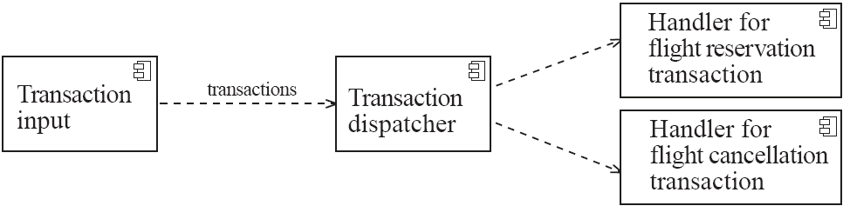
Example of a transaction-processing system

Slide 34
The transaction-processing architecture and design principles
1. Divide and conquer: The transaction handlers are suitable system divisions that you can give to separate software engineers.
2. Increase cohesion: Transaction handlers are naturally cohesive units.
3. Reduce coupling: Separating the dispatcher from the handlers tends to reduce coupling.
7. Design for flexibility: You can readily add new transaction handlers.
11. Design defensively: You can add assertion checking in each transaction handler and/or in the dispatcher.

Slide 35
The Pipe-and-Filter architectural pattern
A stream of data, in a relatively simple format, is passed through a series of processes
Each of which transforms it in some way.
Data is constantly fed into the pipeline.
The processes work concurrently.
The architecture is very flexible.
Almost all the components could be removed.
Components could be replaced.
New components could be inserted.
Certain components could be reordered.

Slide 36
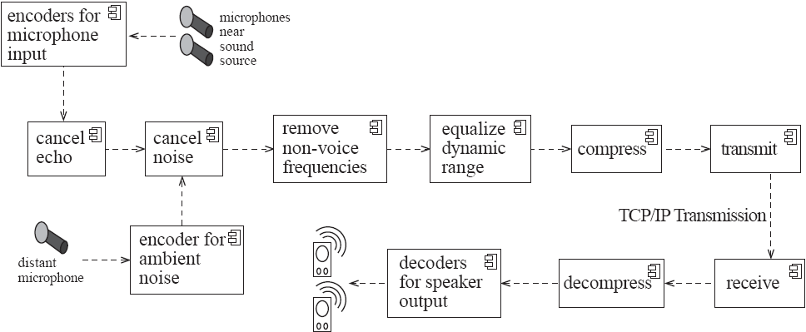
Example of a pipe-and-filter system

Slide 37
The pipe-and-filter architecture and design principles
1. Divide and conquer: The separate processes can be independently designed.
2. Increase cohesion: The processes have functional cohesion.
3. Reduce coupling: The processes have only one input and one output.
4. Increase abstraction: The pipeline components are often good abstractions, hiding their internal details.
5. Increase reusability: The processes can often be used in many different contexts.
6. Increase reuse: It is often possible to find reusable components to insert into a pipeline.

Slide 38
The pipe-and-filter architecture and design principles
7. Design for flexibility: There are several ways in which the system is flexible.
10. Design for testability: It is normally easy to test the individual processes.
11. Design defensively: You rigorously check the inputs of each component, or else you can use design by contract.

Slide 39
The Model-View-Controller (MVC) architectural pattern
An architectural pattern used to help separate the user interface layer from other parts of the system
The model contains the underlying classes whose instances are to be viewed and manipulated
The view contains objects used to render the appearance of the data from the model in the user interface
The controller contains the objects that control and handle the user’s interaction with the view and the model

Slide 40
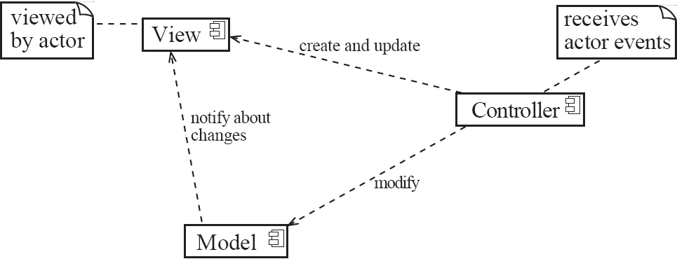
Example of the MVC architecture for the UI

Slide 41
Example of MVC in Web architecture
The View component generates the HTML code to be displayed by the browser.
The Controller is the component that interprets ‘HTTP post’ transmissions coming back from the browser.
The Model is the underlying system that manages the information.

Slide 42
The MVC architecture and design principles
1. Divide and conquer: The three components can be somewhat independently designed.
2. Increase cohesion: The components have stronger layer cohesion than if the view and controller were together in a single UI layer.
3. Reduce coupling: The communication channels between the three components are minimal.
6. Increase reuse: The view and controller normally make extensive use of reusable components for various kinds of UI controls.
7. Design for flexibility: It is usually quite easy to change the UI by changing the view, the controller, or both.
10. Design for testability: You can test the application separately from the UI.

Slide 43
The Service-oriented architectural pattern
This architecture organizes an application as a collection of services that communicates using well-defined interfaces
In the context of the Internet, the services are called Web services
A web service is an application, accessible through the Internet, that can be integrated with other services to form a complete system
The different components generally communicate with each other using open standards such as XML.

Slide 44
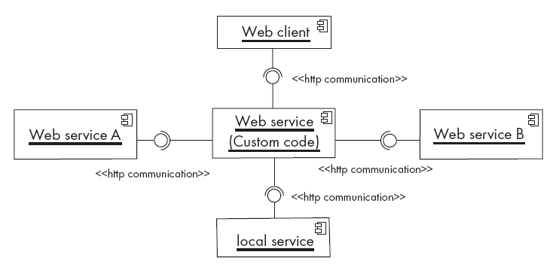
Example of a service-oriented application

Slide 45
The Service-oriented architecture and design principles
1. Divide and conquer: The application is made of independently designed services.
2. Increase cohesion: The Web services are structured as layers and generally have good functional cohesion.
3. Reduce coupling: Web-based applications are loosely coupled built by binding together distributed components.
5. Increase reusability: A Web service is a highly reusable component.
6. Increase reuse: Web-based applications are built by reusing existing Web services.
8. Anticipate obsolescence: Obsolete services can be replaced by new implementation without impacting the applications that use them.

Slide 46
The Service-oriented architecture and design principles
9. Design for portability: A service can be implemented on any platform that supports the required standards.
10. Design for testability: Each service can be tested independently.
11. Design defensively: Web services enforce defensive design since different applications can access the service.

